Slide 1
Biography of Nelson Mandela
By:-
Raghav Maheshwari
118043

Slide 2
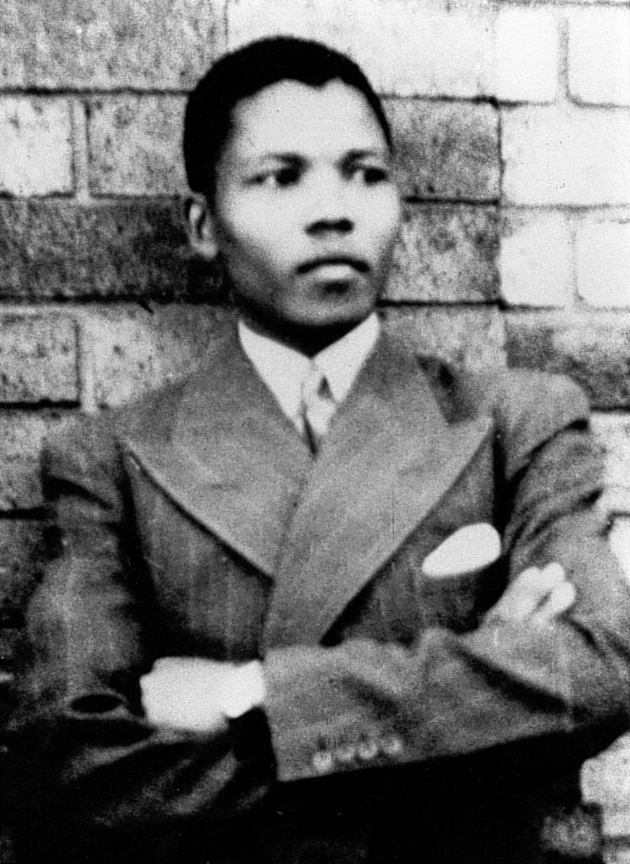
Who was Nelson Mandela?
Nelson Rolihlahla Mandela was a South African anti-apartheid revolutionary, political leader and philanthropist who served as President of South Africa from 1994 to 1999. He was the country's first black head of state and the first elected in a fully representative democratic election.. Rolihlahla Mandela was a Southas born in the village of Mvezo and was a member of the Madiba clan. His father called him Rolihlahla which means ‘troublemaker’! However, when he went to school ,
his teacher gave him the name Nelson because she could
not pronounce his African name.
After school, Mandela went to university
where he studied law and eventually, he became
a lawyer in 1942.

Slide 3
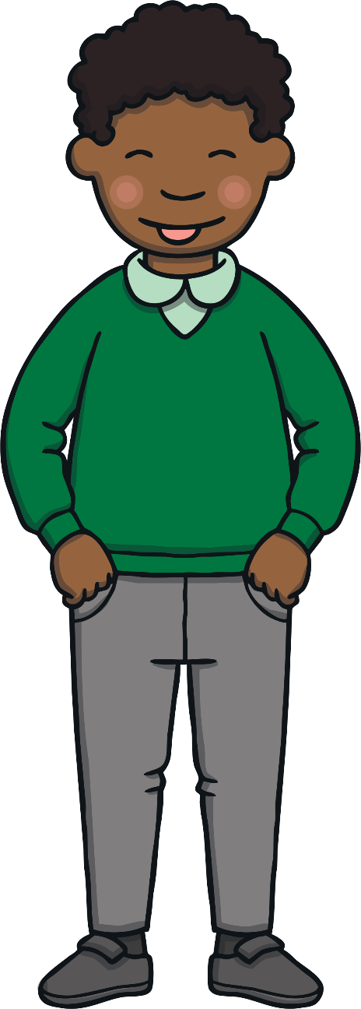
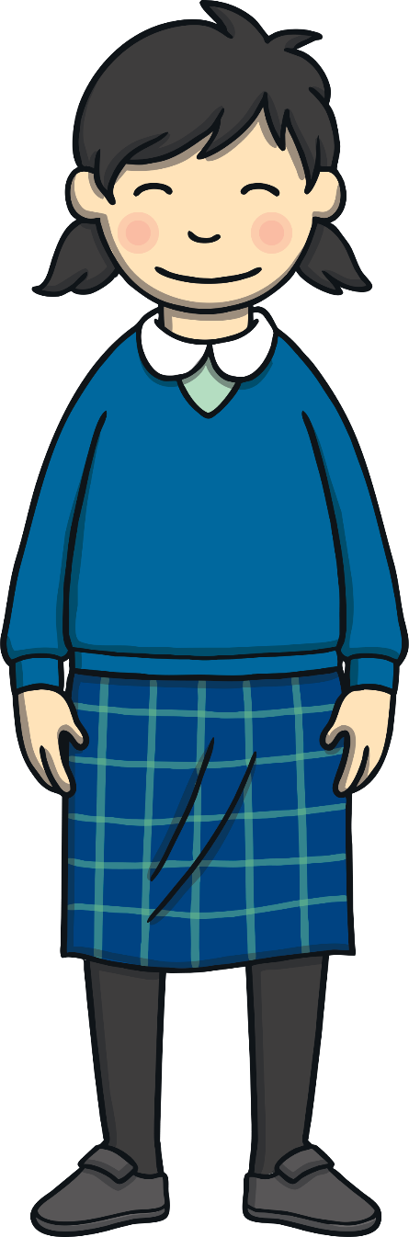
Problems in South Africa
In 1948, the South African government made new laws to keep white people and black people apart. This new system was called the apartheid.
A white person and a black person could not marry, they could not share a table in a restaurant or even sit together on a bus!
Black children and white children even went to separate schools.

Slide 4

The African National Congress
In 1944, Nelson Mandela joined the ANC.
The ANC wanted black South Africans
to have the same rights as white
South Africans. They protested
against the government but
this was dangerous.
In 1956, Mandela and 155
other people were arrested
and Mandela went to prison
for 5 years.

Slide 5
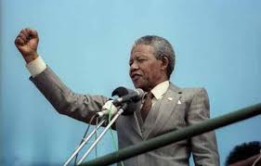
Mandela became the most famous
prisoner in the whole world.
People around the world were
calling ‘Free Nelson Mandela!’
In 1990, South Africa’s president
FW de Klerk finally set Nelson
Mandela free.

Slide 6
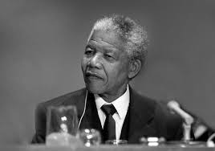
Achievements
. Mandela received more than 260 awards over 40 years, most notably the Nobel Peace Price in 1993.
From 1994 to 1999, Mandela was President of South Africa. He was the first such African to be elected in fully representative democratic polls.

Slide 7
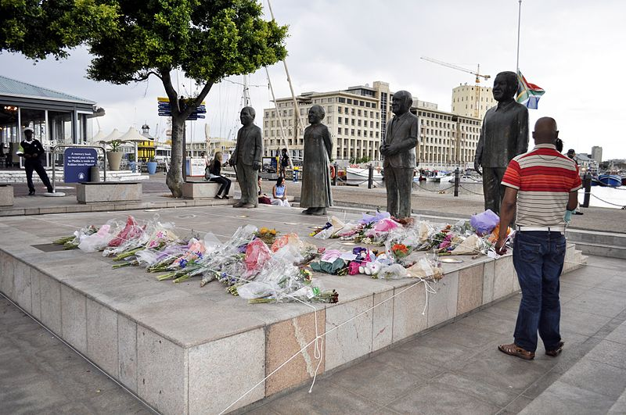
The Death of a Hero
Nelson Mandela died at the age of 95 and people around the world mourned.

Slide 8
Thank you

